Slide 1

Electronic Nose Sensor

Slide 2
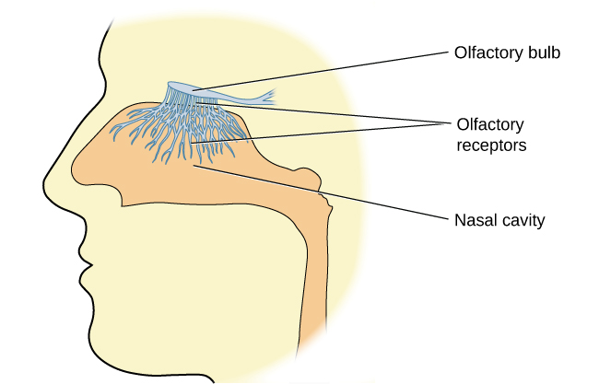
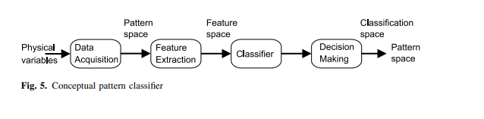
What is Electronic Nose?
Nose mechanism
Sample Delivery System
Detection System
Computing System
An electronic nose as the name suggests is a type of a human nose that detects the smell effectively by using the array of gas sensor.
An electronic nose consists of a mechanism for chemical detection.

Slide 3
Application
Environmental Monitoring - Can detect gases which human nose couldn't like poisonous gas carbonmonoxide.
Medical Diagnosis – Can also be used to deduct disease by sensing blood-glucose levels from one’s breath and sniffing out gut disease by from sample of poops.
Food Industry
Crime Preventions
Quality control labs

Slide 4
References
Research paper - https://link.springer.com/article/10.1007/s00604-006-0623-9
https://phys.org/news/2009-11-e-nose-scientists-electronic-sniffer.html
https://en.wikipedia.org/wiki/Electronic_nose
https://spectrum.ieee.org/meet-the-enose-that-actually-sniffs
Thank You

